Slide 1
The Power of An Introduction
By Angel Rodrigues
Notes:
Toni Morrison opens her novels with powerful introductions that dig their feet deep in the ground from which she builds her stories. Morrison uses “compositional semantics,” to create sentences that mean more than what is composed within them (Curzan, 204). The relationship between each component of the sentence conveys a larger concept, but by studying the semantics of what is being said between each component, readers find all the beautiful bits of her writing. In Love, Tar Baby, and Song of Solomon, Morrison opens her stories by introducing her powerful ideas in between simple words, expressions, and phrases.

Slide 2


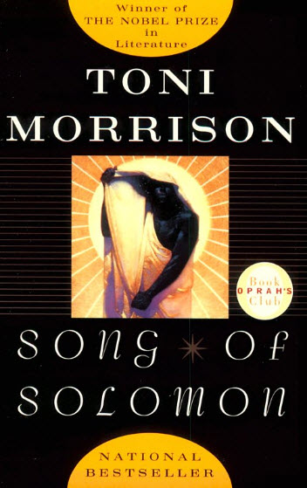
Toni Morrison
Love
Tar Baby
Song of Solomon
Notes:
Each book represents a piece of Morrison’s creative world comprised of semantics, reference points, linguistic experiments, and polysemy. The world in which Morrison’s stories exist are historically connected to a time and place in African American culture and often she makes references that could be identified by someone familiar with its references, creating an intimate bond with her readers through these connections and references.

Slide 3
Love
Notes:
Morrison, Toni. Love. Vintage Press. New York, NY. 2005

Slide 4
Passage
“The women’s legs are spread wide open, so I hum. Men grow irritable, but they know it’s all for them. They relax. Standing by, unable to do anything but watch, is a trial, but I don’t say a word.”
Notes:
(Page 1) Love.

Slide 5
Cliff Notes Paraphrasing
What Was Said:
What It Might Mean:
“The women’s legs are spread wide open, so I hum. Men grow irritable, but they know it’s all for them. They relax. Standing by, unable to do anything but watch, is a trial, but I don’t say a word.”
Words are powerful.
So Are Women.
Men Have to Be Strong.
More Can Be Said, With Non-Verbal Communication.
Notes:
“Beginning with this connection between language and social norms, L asserts that she hums rather than speaks because the women’s legs are spread wide open: her verbal silence is a response to perceived sexual affront,” (Wallace, n.d.). Love has many forms and Morrison opens her novel with the most powerful aspect of women’s sexuality and power, which is the non-verbal communication that can be spoken to a man, creating a universal language without so much as a word, but only a hum communicated. Morrison conveys much in her writing while utilizing the least amount of words while conveying multitudes more.

Slide 6
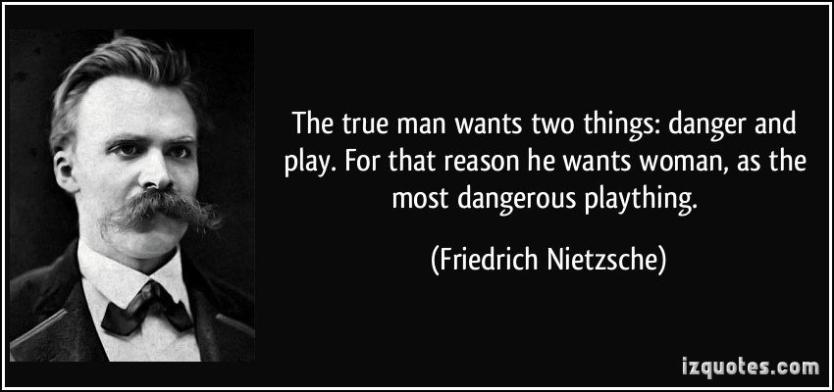
Imagery
Despite the open legs and men nearby, the imagery conveyed in this passage is that of a controlled environment, creating tension and danger.
“Sex is difficult to write about because it’s just not sexy enough. The only way to write about it is not to write much.”
“Sex is difficult to write about because it’s just not sexy enough. The only way to write about it is not to write much.”
Notes:
Toni Morrison during an interview in The Paris Review article The Art of Fiction, spoke about sex being difficult to write about.

Slide 7
Tar Baby
Notes:
Morrison, Toni. Tar Baby. Vintage Press. New York, NY. 2004.

Slide 8
Passage
“He believed he kept me safe. He stood at the railing of H.M.S. Stor Konigsgaarten and sucked in great gulps of air, his heart pounding in sweet expectation as he stared at the harbor. Queen of France blushed a little in the lessening light and lowered her lashes before his gaze.”
Notes:
(Page 1) Tar Baby.

Slide 9
Cliff Notes Paraphrasing
What Was Said:
What It Might Mean:
“He believed he kept me safe. He stood at the railing of H.M.S. Stor Konigsgaarten and sucked in great gulps of air, his heart pounding in sweet expectation as he stared at the harbor. Queen of France blushed a little in the lessening light and lowered her lashes before his gaze.”
A woman is being seduced by a man without him touching her.
Women of honor would be embarrassed by the sexual tension in the room.
Both of them knew they would become lovers.
Notes:
Morrison uses compositionality to ask readers to dissect the meaning of the words and what they interject into the meaning of the sentence in an overall idea. Not only are readers to paraphrase what she means by the man standing there taking in large amounts of air, as if he is almost breathless in her presence, but the meaning behind the Queen of France adds more than just a name to the introduction, but a larger meaning compositionally. While the light was turning to dark, this symbolic Queen, a proper high society woman closed her eyes and let him have her. Morrison said all of this in the paraphrasing, subtext, and composition while using few words composed into a tightly written sentence.

Slide 10
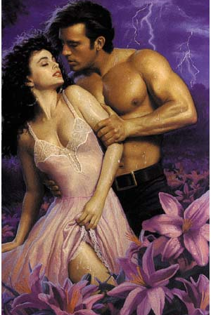
Imagery
The night was closing in and so was their passion. People standing by watching would know exactly what was about to take place and look the other way, because even they knew there would be no stopping them or their passion.
Notes:
Morrison has her own style of sexuality in her novels that is raw, conveying imagery of a romance novel, but void of fake whimsy and male dominance. Women are often in control and those that are not and being abused often get revenge is some way or another, even if it is through karma.

Slide 11
Song of Solomon
Notes:
Morrison, Toni. Song of Solomon. Vintage Press. New York, NY. 2004.

Slide 12
Passage
“The North Carolina Mutual Life Insurance agent promised to fly from Mercy to the other side of Lake Superior at three o’clock. Two days before the event was to take place he tacked a note on the door of his little yellow house:
        At 3:00 p.m. on Wednesday the 18th of February, 1931, I will take off from Mercy and fly away on my own wings. Please forgive me. I loved you all.
                (signed) Robert Smith,
                Ins. agent”
Notes:
Page 1, Song of Solomon.

Slide 13
Cliff Notes Paraphrasing
What Was Said:
What It Might Mean:
“The North Carolina Mutual Life Insurance agent promised to fly from Mercy to the other side of Lake Superior at three o’clock. Two days before the event was to take place he tacked a note on the door of his little yellow house:
        At 3:00 p.m. on Wednesday the 18th of February, 1931, I will take off from Mercy and fly away on my own wings. Please forgive me. I loved you all.
                (signed) Robert Smith,
                Ins. agent”
A man leaves a note instead of facing everyone person to person.
He is either ashamed or afraid.
This man is an insurance agent, so he has already assessed the risks of the situation and felt this was the best action to take.
The man is taking off two days before a big life event after being a hospital and leaves his “yellow” house, a color synonymous with caution.
He takes measure to say “loved” you all, as it is past tense.
Notes:
The novel opens with this letter, causing readers to ask what is exactly going on in between the spaces of this introduction. What event is taking place? Why is the man leaving in such a secretive way? Where is he going? With whom is he going with if anybody? Morrison introduces characters, story, setting, imagery, theme, and interest of her readers from the very onset of her first paragraphs.

Slide 14

Imagery
Whatever the reasons, this man is willing to throw caution to the wind and take off from everyone he “loved” and set off running from the hospital, maybe because of something that happened there or maybe because he isn’t ready to deal with the realities that come after the hospital. He is asking for Mercy, a play on words.
Notes:
The yellow house the insurance agent lives in is symbolic and could have a larger connotation, creating a reaction when the insurance agent leaves caution and takes off from Mercy, symbolized by a hospital name. The man may have been in a literal hospital and lived in a literal yellow house, all denotative, but it is the connotation of each aspect that speak to the larger meanings in between the semantics in Morrison’s writing. Analogical mapping helps readers “draw relations among meanings within cognitive process,” which helps understand the larger picture of what is going on (Curzan, 220).

Slide 15
Works Cited
Curzan, Anne. Adams, Michael. How English Works: A Linguistic Introduction. Longman Pearson Education. Inc. 2012.
Insurance Agent Photo. Retrieved from the Web September 3, 2016. https://3.bp.blogspot.com/-j4BzFh2bnvY/VtbRVqTNpII/AAAAAAAAB_A/bTHqf8sreuk/s400/orphan-life-insurance-policy.jpg
Love Photo Retrieved from Web September 2, 2016: https://upload.wikimedia.org/wikipedia/en/b/b3/Love_(Toni_Morrison_novel_-_cover).JPG
Love Lace Media Photo. Retrieved from Web September 3, 2016. https://lovelace-media.imgix.net/uploads/140/75d36fb0-fe57-0133-8059-0e31b36aeb7f.jpe?w=700&fit=max&auto=format&q=70
Lovers Wanting Photo Retrieved From The Web September 3, 2016. http://www.drwendywalsh.com/blog/wp-content/uploads/2012/02/cover_3.jpg
Morrison, Toni. Love. Vintage Press. New York, NY. 2005
Morrison, Toni. Song of Solomon. Vintage Press. New York, NY. 2004.
Morrison, Toni. Tar Baby. Vintage Press. New York, NY. 2004.
Nietzche, Friedrich. Photo Retrieved from Web September 3, 2016. http://www.returnofkings.com/wp-content/uploads/2015/06/fn.jpg
Tar Baby Photo Retrieved from Web September 2, 2016: https://foxtaylor.files.wordpress.com/2014/11/tar-baby-by-toni-morrison.jpg
Schappell, Elissa, and Claudia Brodsky Lacour. "Toni Morrison, The Art of Fiction No. 134." The Paris Review Fall 128 (1993): n. pag. Web. 31 Aug. 2016.
Song of Solomon Photo Retrieved from Web September 2, 2016: https://foxtaylor.files.wordpress.com/2014/11/tar-baby-by-toni-morrison.jpg
Wallace, Cynthia. Of Women Borne: A Literary Ethics of Suffering. Columbia Univeristy Press. 2016.
Notes:
Morrison, Toni. Love. Vintage Press. New York, NY. 2005

